Slide 1
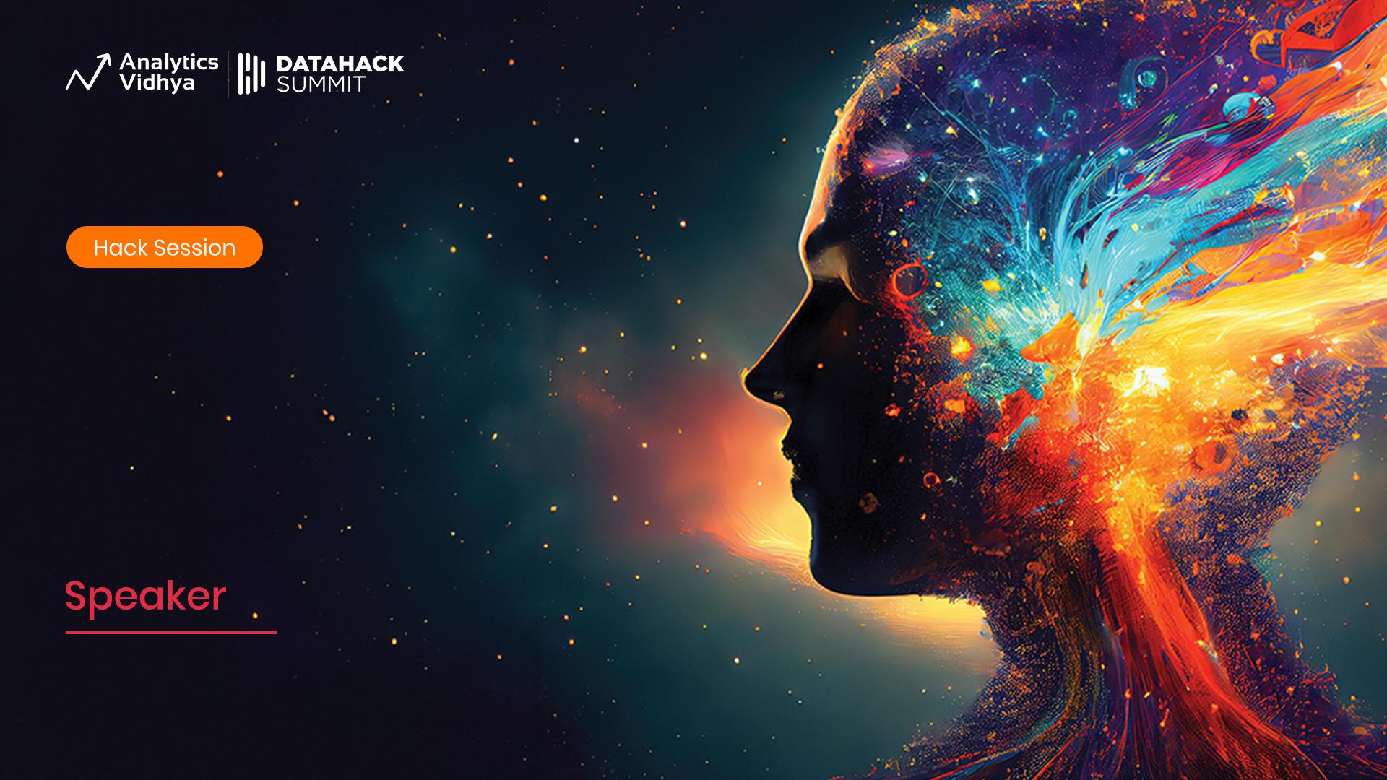
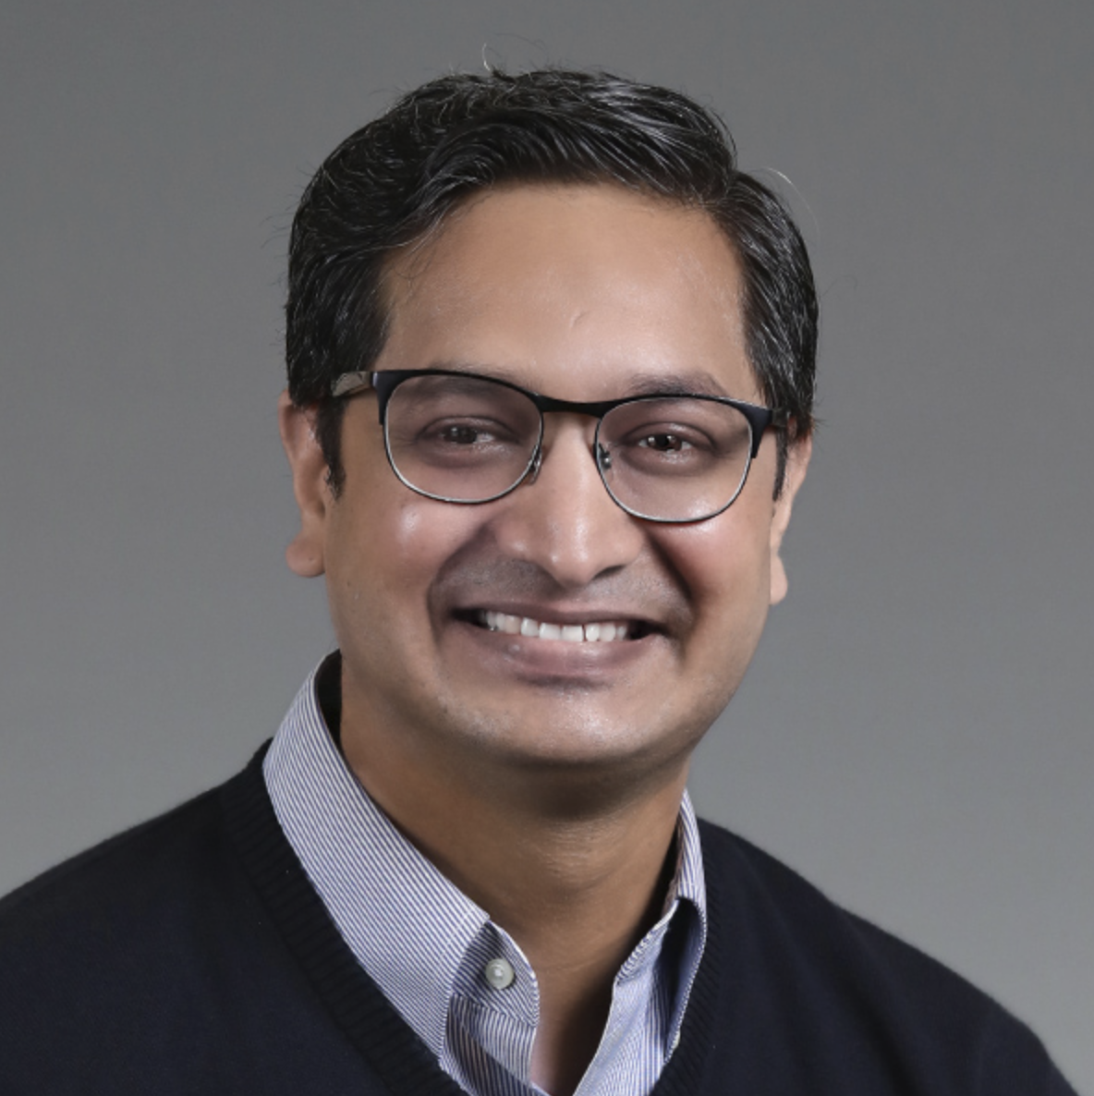
Workshop
Mastering Stable Diffusion
Module 6
State of Art and Cutting Edge of Stable Diffusion
Sandeep Singh
Head of Applied AI, Beans AI

Slide 2
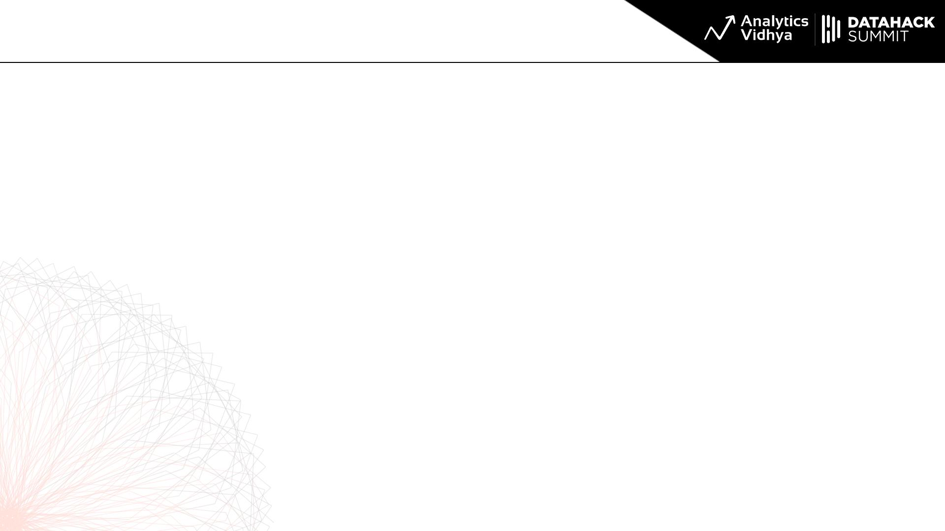
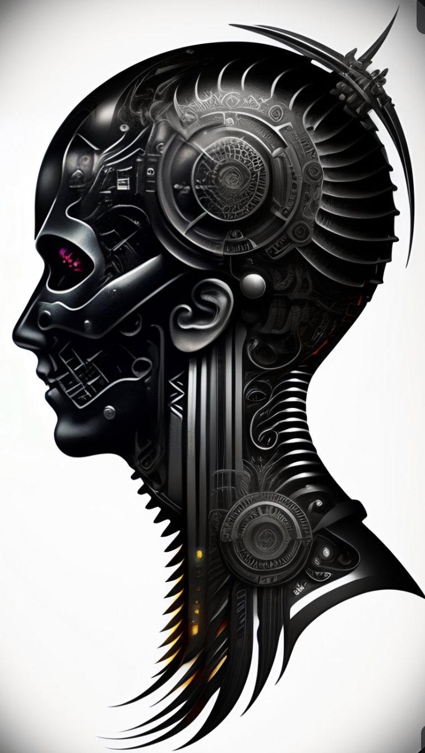
Module 6 Purpose
Theme of this module is: What is the cutting edge and state of art of Stable Diffusion.
Cutting Edge Paper Review: InstructPix2Pix
InstructPix2Pix Introduction and Setup.
InstructPix2Pix Demo and hands-on.
Cutting Edge ControlNet: Introduction and Setup.
Generating Image Variations with ControlNets.
Awe Inspiring Use Cases of ControlNets.
ControlNets OpenPose: Use of Human pose in Image Editing.
Quick Paper Review: Super Resolution
UpScaling Images with Ultimate SD UpScale + ControlNets

Slide 3
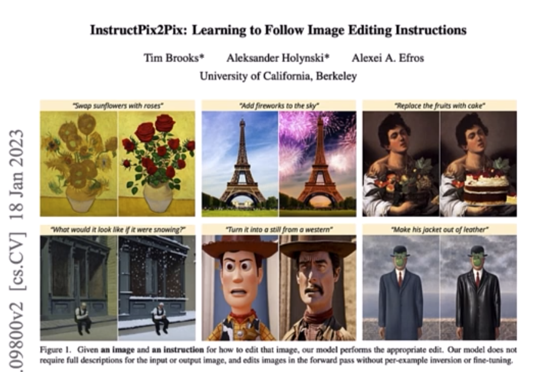
Paper Review: InstructPix2Pix
It is Image Editing Assistance.
Very Clever way to merge GPT Language model and Stable Diffusion.
Uses lots of Data but none of that is created manually.
Github: https://github.com/timothybrooks/instruct-pix2pix
Can be installed using download file method in WebUI notebook.
HuggingFace Space is: https://huggingface.co/timbrooks/instruct-pix2pix/tree/main
download_file(
'https://huggingface.co/timbrooks/instruct-pix2pix/tree/main',
'instruct-pix2pix-00-22000.safetensors'
)

Slide 4
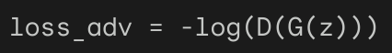
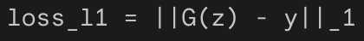
Paper Review: InstructPix2Pix Data and Loss Function
Data at: http://instruct-pix2pix.eecs.berkeley.edu/
GPT Generated Prompts: http://instruct-pix2pix.eecs.berkeley.edu/gpt-generated-prompts.jsonl
The loss function in the Instruct Pix 2 Pix paper is a combination of two loss functions:
The adversarial loss and The L1 loss
where D(G(z)) is the discriminator's output for the generated image G(z).
The L1 loss is a measure of the pixel-wise difference between the generated image and the target image
where LAMBDA is a hyperparameter that controls the weighting of the two loss terms.
Intuition to remember:
The adversarial loss encourages the generator to produce images that are realistic and indistinguishable from real images.
The L1 loss encourages the generator to produce images that are structurally similar to the input image.

Slide 5
Paper Review: InstructPix2Pix Use
Remember: In InstructPix2Pix, we describe the action to take, Not the description of the final image.
Demo InstructPix2Pix with instructPix2Pix_1.png - Make her wear suit and tie - Change the color of Tie - Change the color of hairs - Make her wear a hat

Slide 6
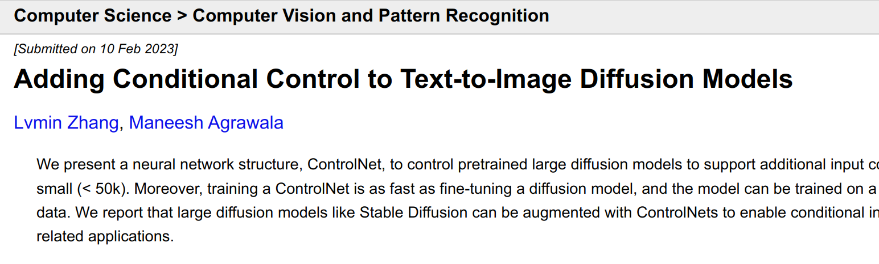
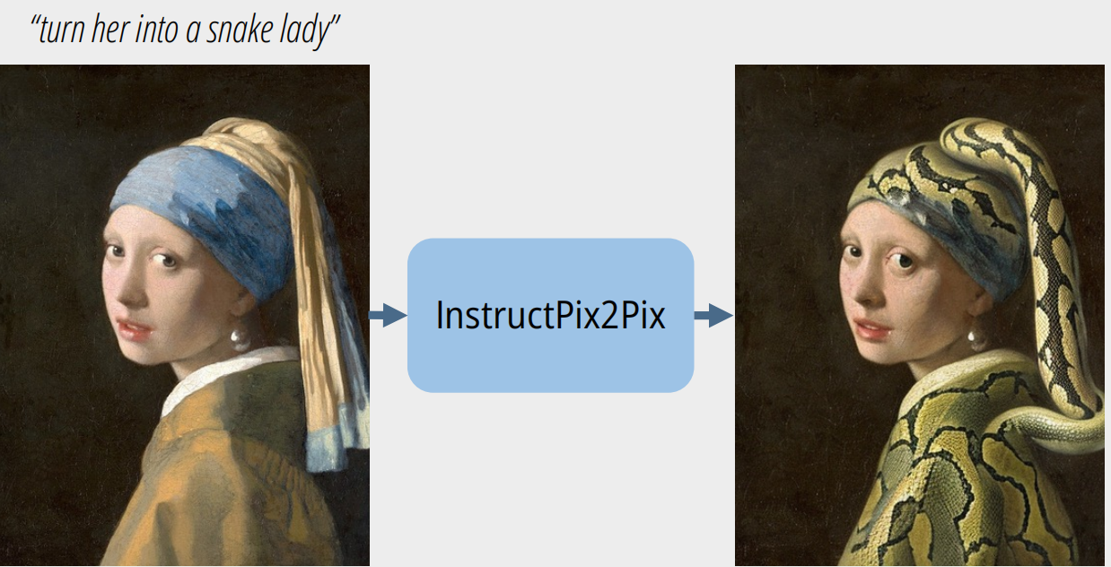
ControlNet: New Horizon
Paper: https://arxiv.org/abs/2302.05543
Mind-blowing: It is very hard to do in today’s time
in AI research field.
It is amazing because of two reasons: - It reduced the training time by 90%. From 1000s of GPU hours to 100s of GPU hours - It produced amazingly stunning results.
ControlNet is : (Text and Image) ⇒ Image
A picture is worth 1000 words, but to generate the image in our minds, it is hard to write 1000 appropriate words. ControlNet saves the day here with: 10 words and input image worth 990 words!

Slide 7
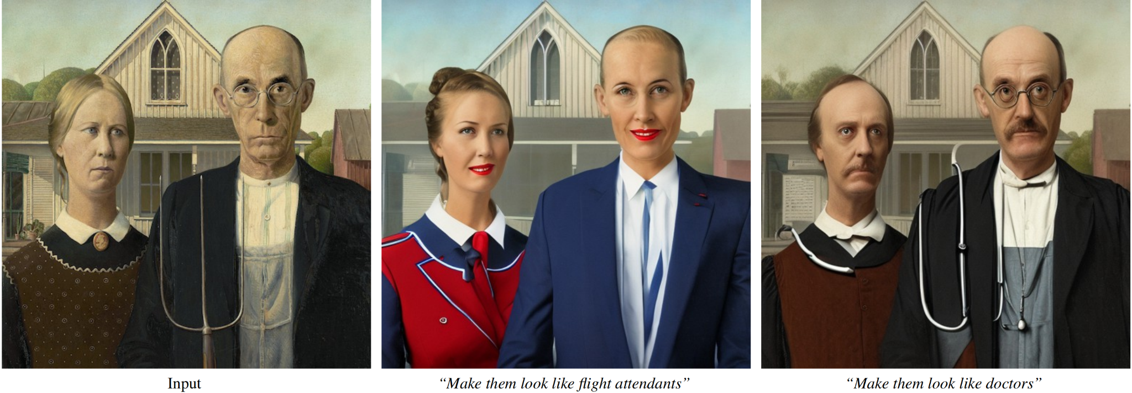
ControlNet: Inspiration
By providing input image with the prompt we: Do not need to provide a lots of implicit details!
Imagine writing a lot of details into text to generate the whole image by using just the text to image model like Stable Diffusion.

Slide 8
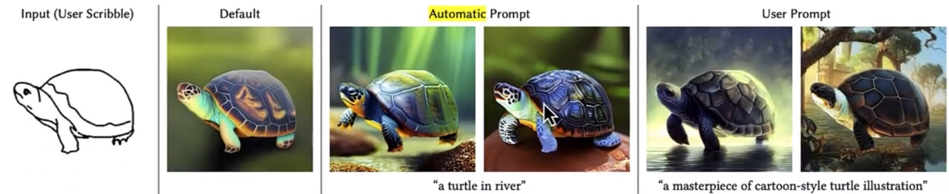
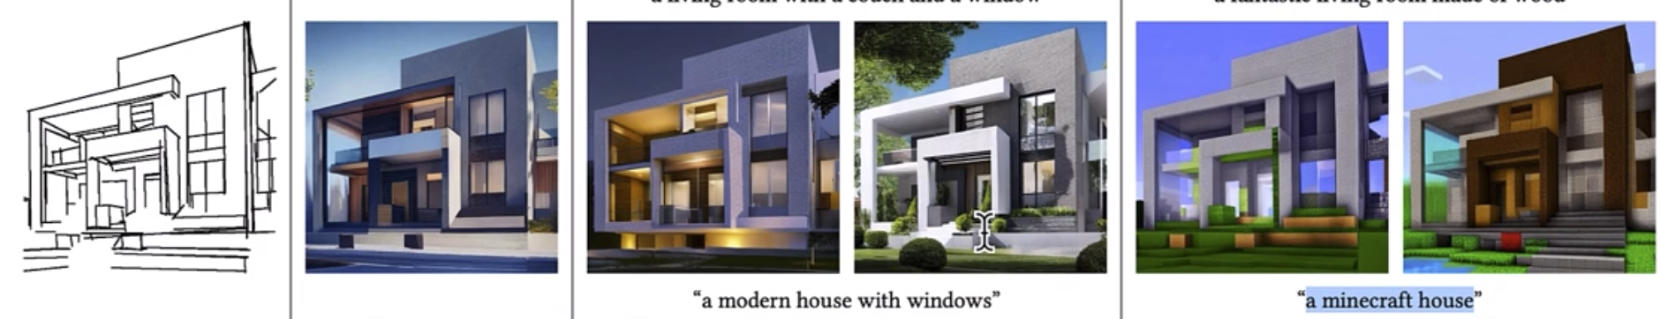
ControlNet: Inspiration
Can be used to convert Doodles or Sketches to Images as:
It can also take Canny Edges of the scene and create the full resolution images as:

Slide 9
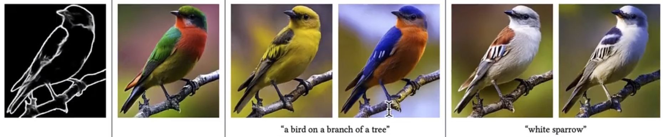
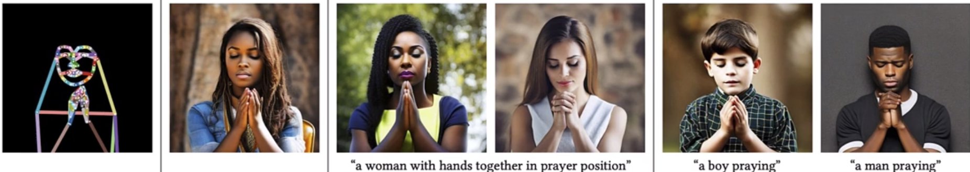
ControlNet: Inspiration
Quality of the output is almost like Digital Cameras, without giving camera parameter type Prompt!

Slide 10
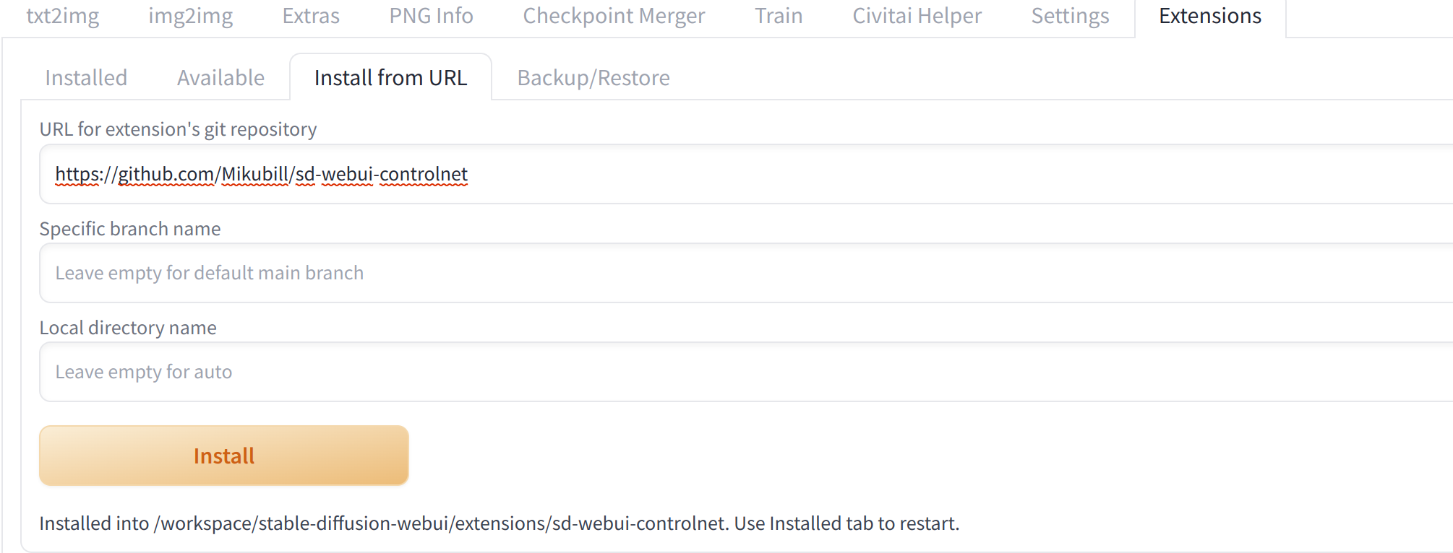
ControlNet: Installation and Setup
We use Extensions tab of WebUI to install ControlNet: https://github.com/Mikubill/sd-webui-controlnet

Slide 11
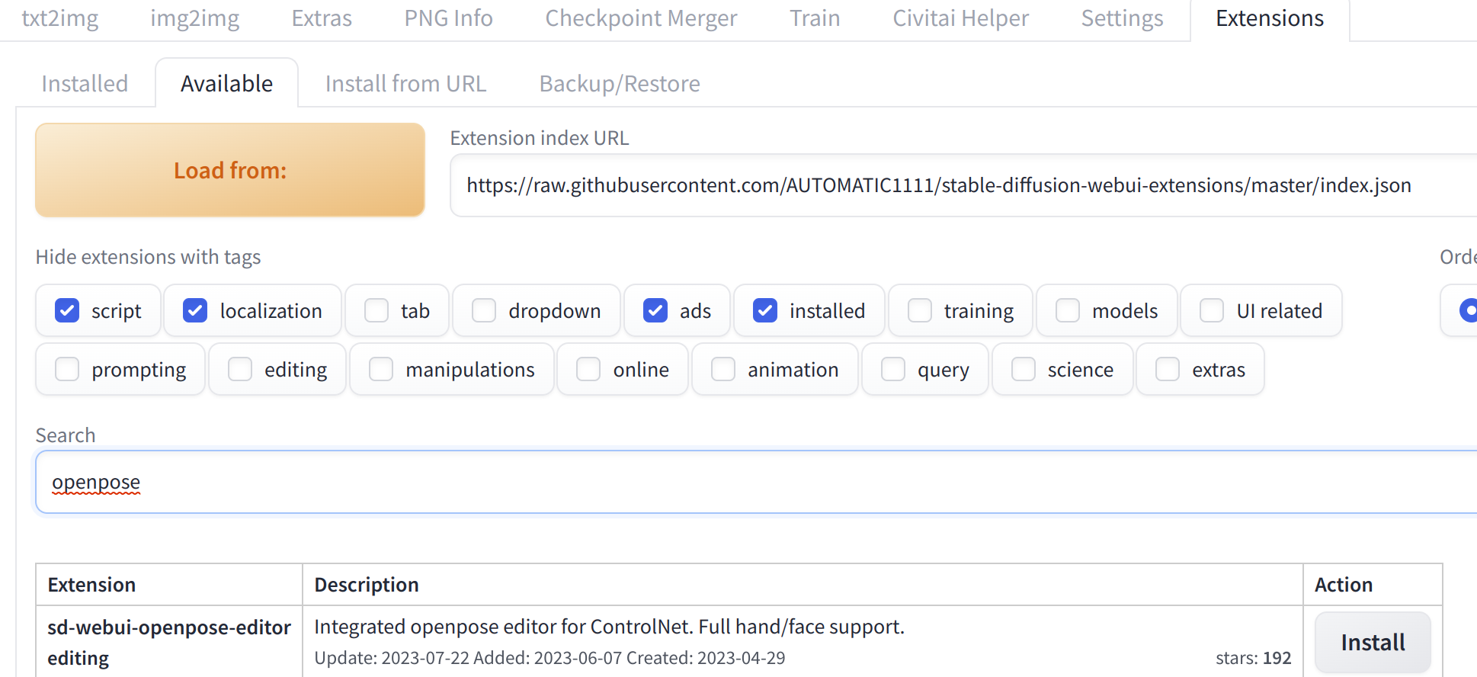
Pose Editor Extension Installation
We will use this to demo some ControlNet Use cases

Slide 12
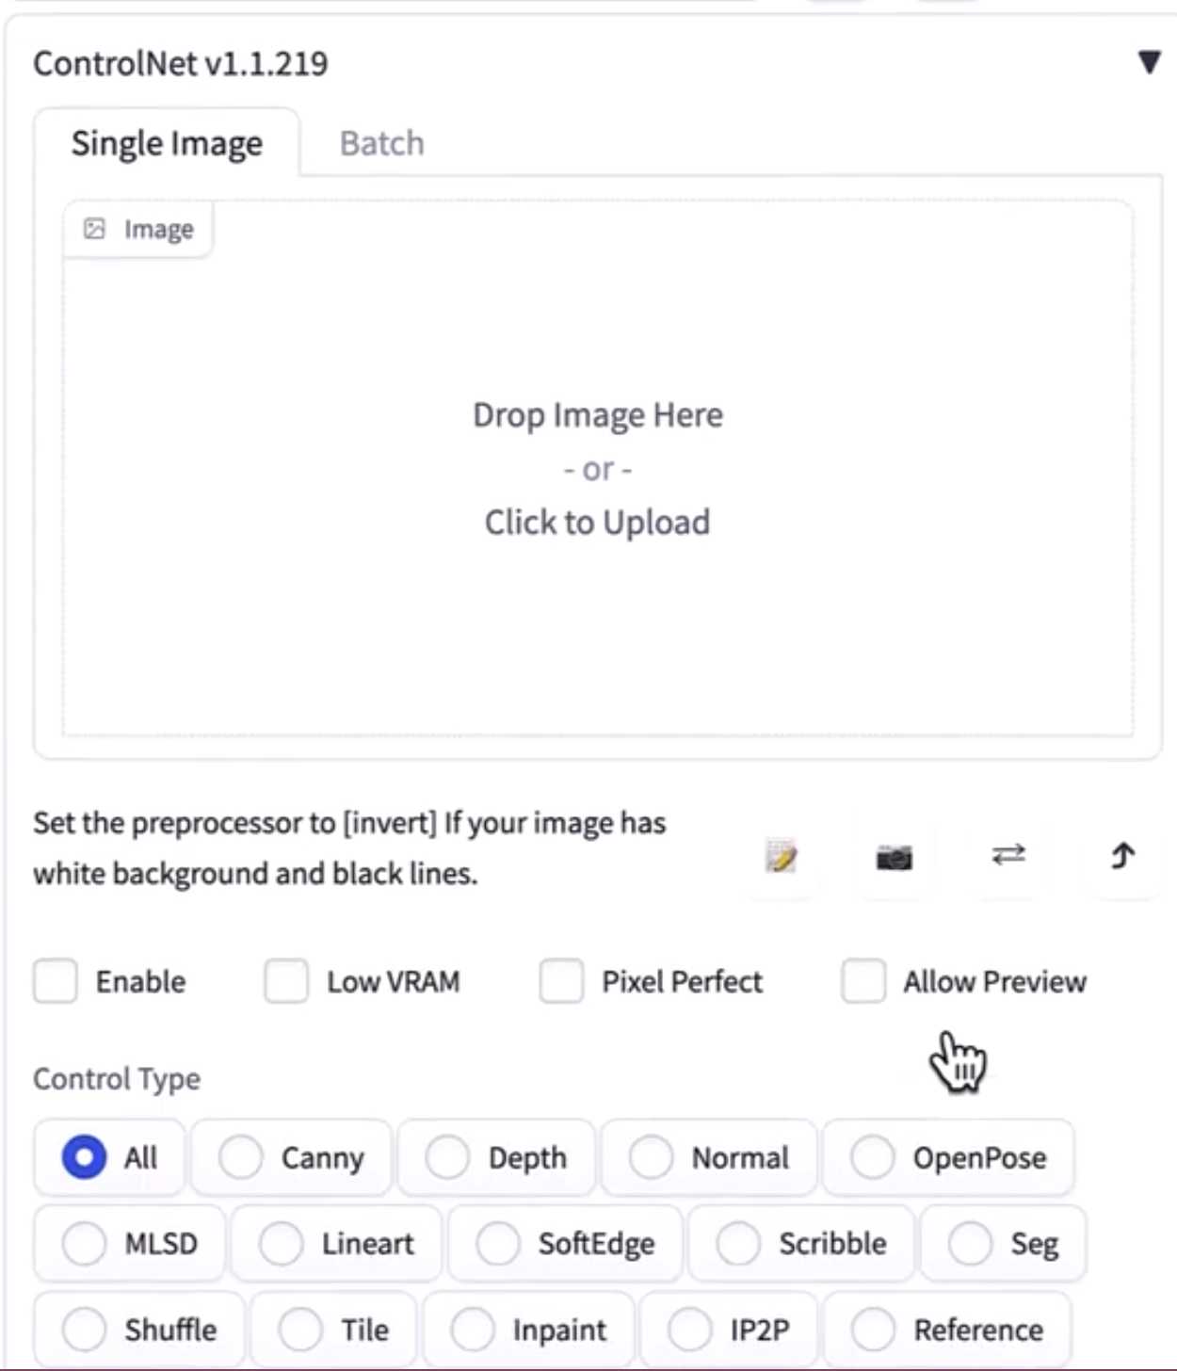
ControlNet: Download Models
Download the model files from: https://huggingface.co/lllyasviel/ControlNet-v1-1/tree/main
Place then in Stable Diffusion WebUI Extensions Folder as:
If everything is in place and you restart your WebUI, you will see ControlNet in UI as:
As we can see it has lots of preprocessors like Canny Edge
ControlNet is Collection of Models, Not Just one Model.
It enables new direction of research very easily.

Slide 13
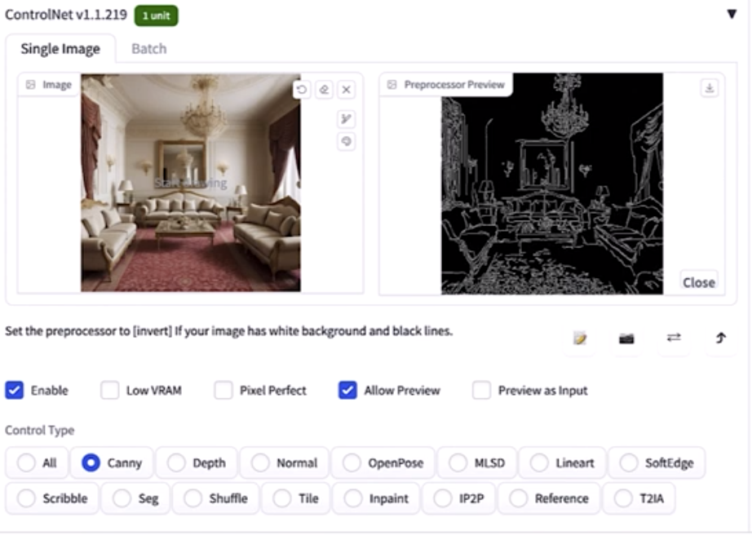
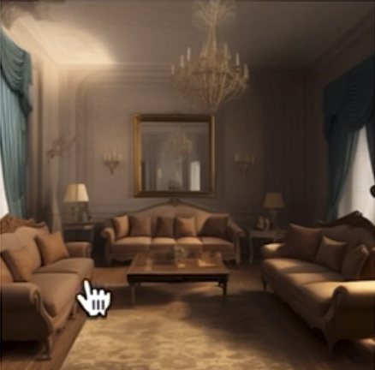
ControlNet: Using the ControlNet Models
Note that ControlNet Model needs two Inputs: 1. Text Prompt as usual Text-2-Image model 2. Input image, which is used for conditioning the generated Image.
Input image with text is not always full image, instead it is some form of preprocessed image. So, We need to decide what out input image will look like. I.e. Which type of preprocessor model has to be used.

Slide 14
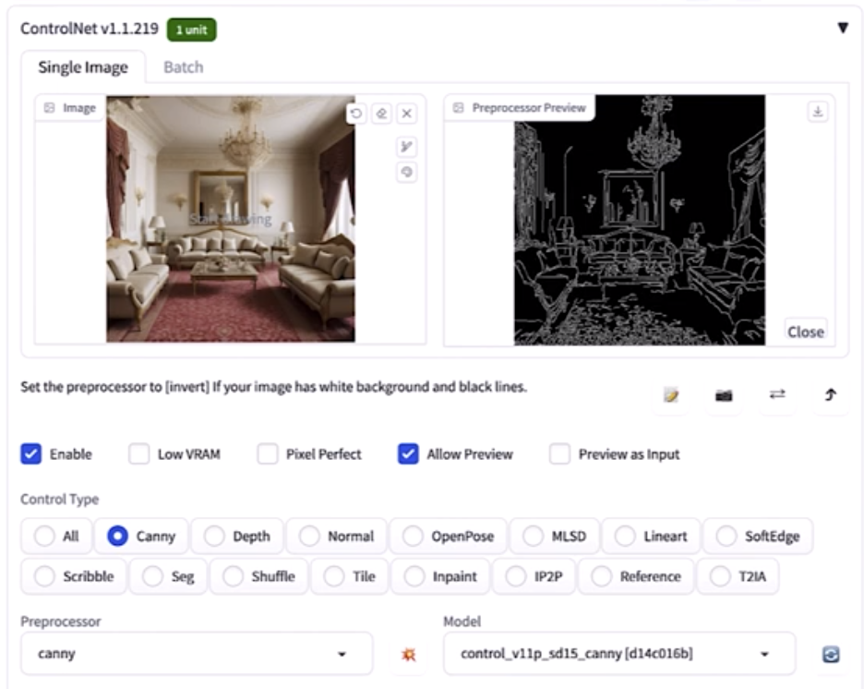
ControlNet: Instruction to Use
Go to text2Img tab in Stable Diffusion.
Expand ControlNet form by clicking it.
Click on ‘Enable’ and ‘Allow Preview’
Select Preprocessor model.
Select ControlNet generator model.
Click on ‘bomb’ icon to see the Preview.
Finally Click on Generate to see the results.

Slide 15
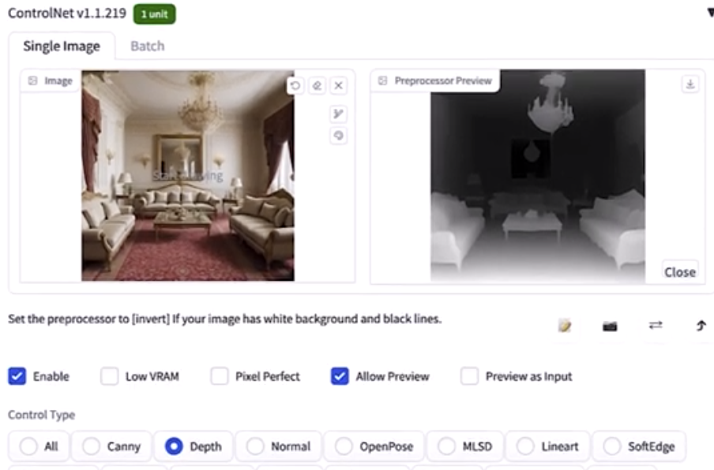
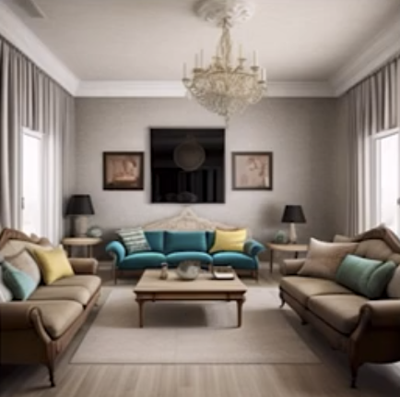
ControlNet: Depth Map Preprocessing
ControlNet has Depth map preprocessor to generate depth map to be used as input along with Text Prompt.
DepthMap as input is very useful as it concentrates on Objects and their continuity. This is in contrast, very different where edges can be detected at any place.
“modern living room”
Note that edges at carpets can cause artifacts for ControlNets, Hence Depth map input is more appropriate.

Slide 16
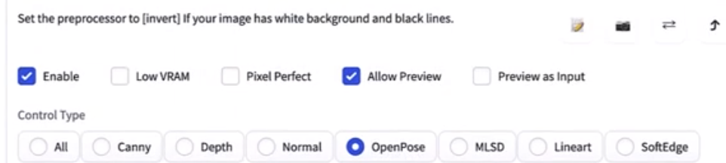
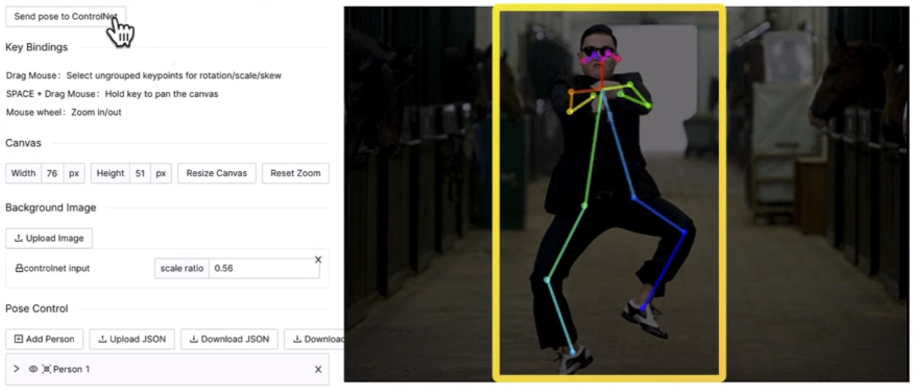
ControlNet: Open Pose as Input
ControlNet can take Human Pose estimation as input along with Text Prompt to generate the image.
This gives immense control over the desired imagination.
Make sure OpenPose is installed and Enabled.
Choose Open Pose Preprocessor.
Pose Editor Extension lets us edit the estimated pose by preprocessor as below:

Slide 17
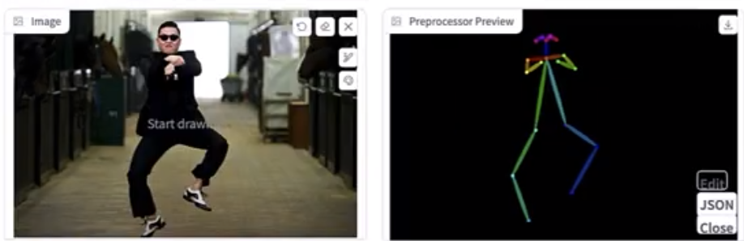
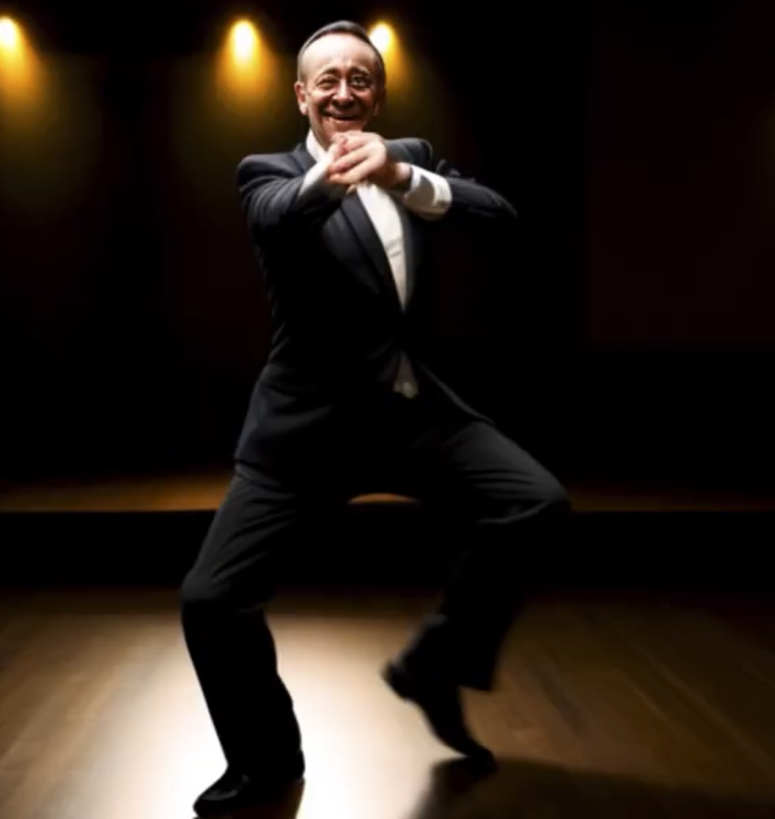
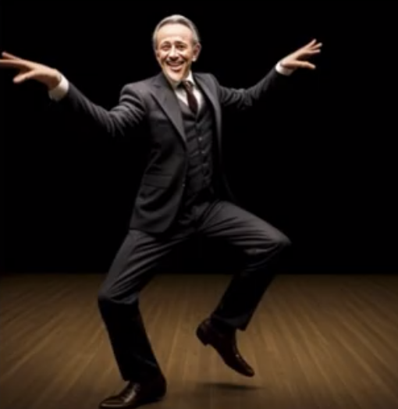
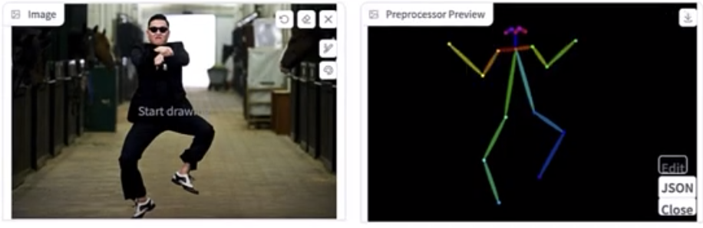
ControlNet: Open Pose Application
“a person dancing”
After Editing the pose estimated
“a person dancing”

Slide 18
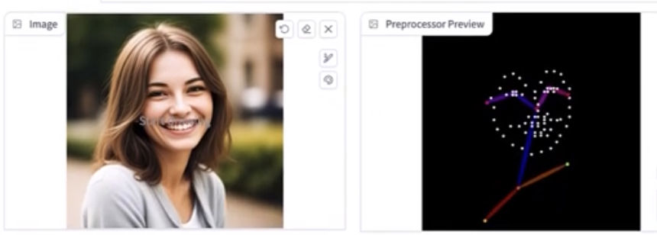
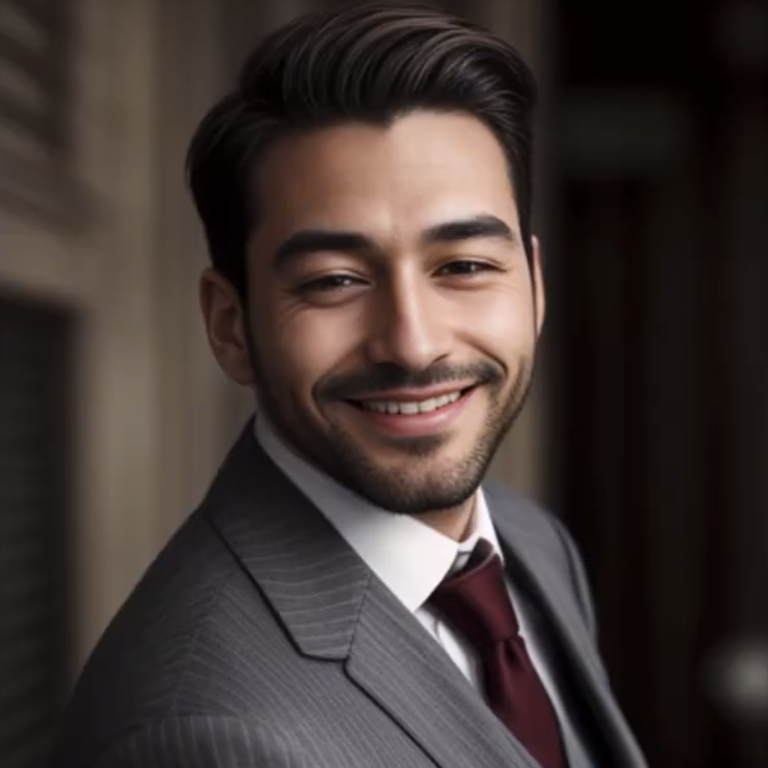
ControlNet: OpenPose_FaceOnly
This is the preprocessor, which only estimates face and shoulders, i.e. Upper body posture with facial landmarks.
“a man”
Note here that: Upper body posture and shoulders with facial expressions remain same, while picture has change in fundamental ways. E.g. women to man, outdoor to indoor etc.

Slide 19
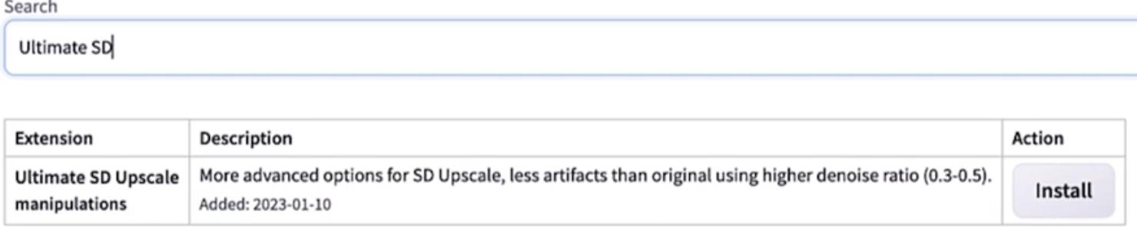
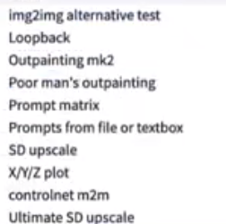
UpScaling Images with Ultimate SD UpScale + ControlNets
ControlNet has a very useful and efficient use to : Up-scale the images without losing details on commodity hardware.
Install the extension from Stable Diffusion WebUI as:
Install and restart the Stable Diffusion WebUI.
After restart, Under Img2Img tab, we will have “SD upscale” option as here:

Slide 20
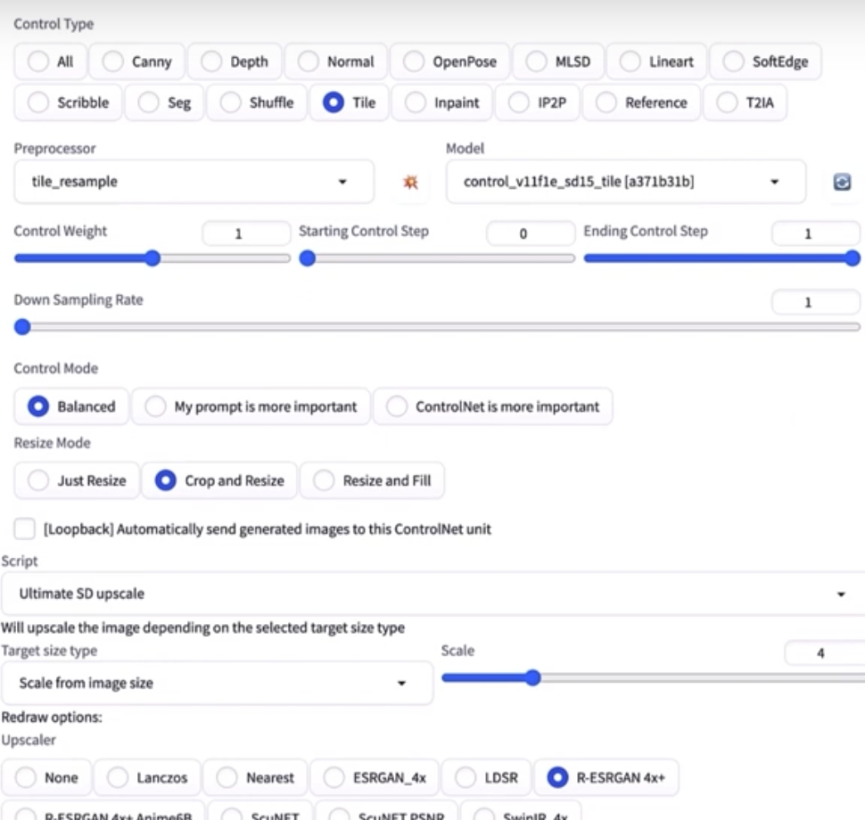
UpScaling Images with Ultimate SD UpScale + ControlNets
Usual Upscaling causes pixelation for image and it looks bad picture.
Even GAN based up samplers cause artifacts which are not coherent holistically in image. This is addressed by ControlNets Ultimate SD up-sampler.
We still use GAN based up-samplers, but with new tilling strategy by ControlNet’s “Tile” preprocessor.
Choose the GAN from options below.

Slide 21
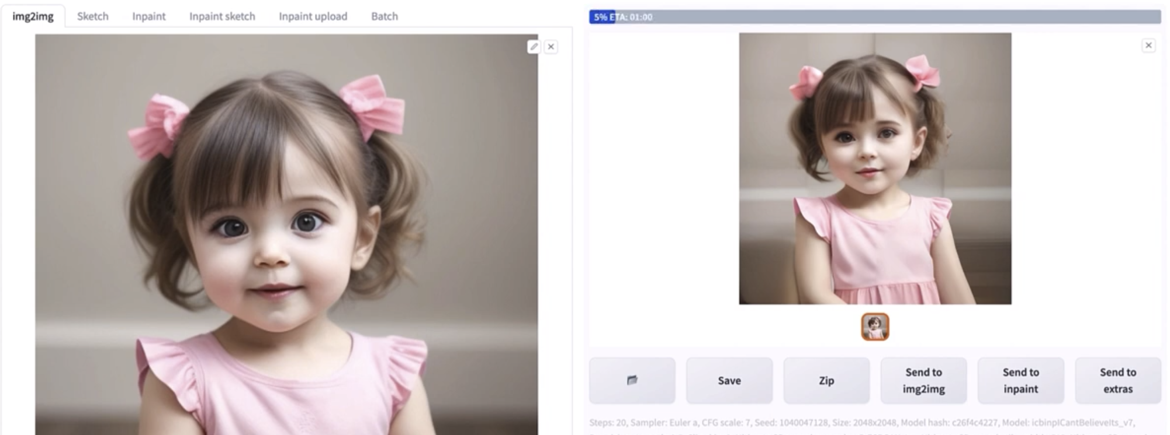
UpScaling Images with Ultimate SD UpScale + ControlNets
Example up-sampling below increases the image size without loss of information or any artifacts in image.

Slide 22
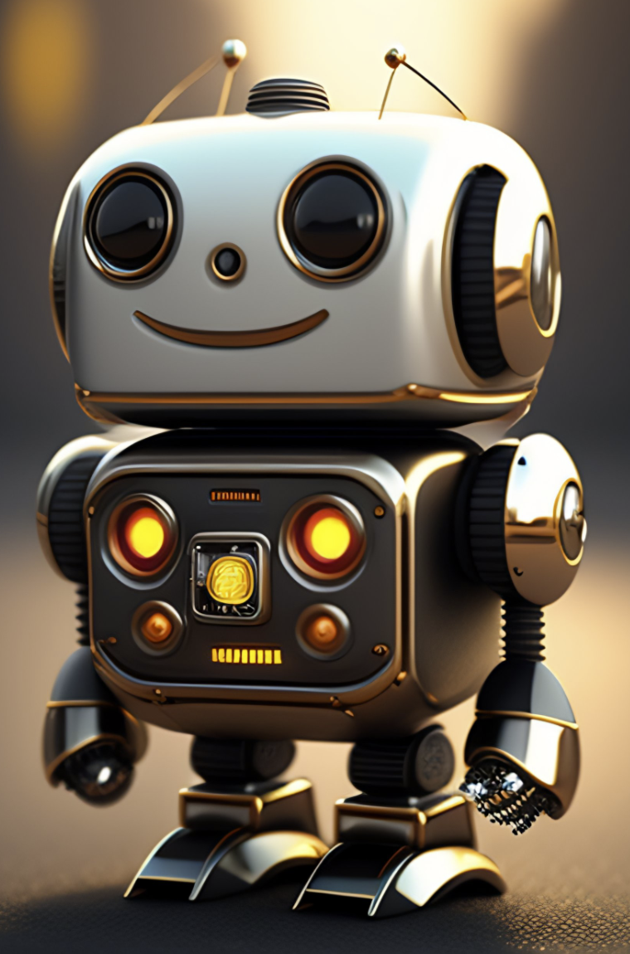
Questions?

Slide 23

!

